Slide 1


GROUP NO. - 35
Presented by:
Kumar Saurav (USN: 1SI18ME047)
Chitransh Shekhar (USN: 1SI18ME024)
Devesh Anand (USN: 1SI18ME027)

Slide 2

Mini Project Presentation
Under the guidance of
Dr. H R Purushothama
Professor & Head at Department of Mechanical Engineering

Slide 3
Sl. No. | Topic | Slide No.
1. | Title | 04
2. | Objectives | 05-06
3. | Outcomes of literature review | 07
4. | Scope and Motivation | 08-09
5. | Methodology | 10
6. | Fabrication requirements | 11
7. | Theoretical Power Calculations & Table | 12-13
8. | Working | 14
9. | Exploded & 360° View | 15
10. | Analysis | 16
11. | Work Plan | 17
12. | Expected Outcome | 18
13. | Cost Estimation | 19
14. | References | 20

Slide 4
TITLE
“PROTOTYPE OF MECHANICAL FOOTSTEP POWER GENERATOR”
This design, after fabrication will convert “mechanical energy” to “electrical energy”.
Prototype: As this is an early sample model built to test a concept.
Footstep: It is used in title to show the production of electricity, using movement of footsteps.
Generator: It’s used as this model generates electricity.
Mechanical
Energy
Electrical Energy

Slide 5
OBJECTIVES
The main aim of this project is to develop a much cleaner way of power generation.
A successful model of this, will help to bring down the global warming as well as help in reducing the power shortages.
The model will help in converting waste energy of foot power to some useful electrical energy, which can be utilized further or saved for later usage.

Slide 6

OBJECTIVES (Continued)
Implementing this model in places where movement of people is abundant (like Gym Health Centre, Exercises equipment, Hospital), will generate electric energy, which will reduce the load & dependency on non-renewable resources of energy.

Slide 7
OUTCOMES OF LITERATURE REVIEW
In our model, we have used rack and pinion mechanism, as it has fewer parts, is lighter and is easy to repair compared to other mechanism.
Our model uses gear train to increase the speed of rotation of motor shaft.
As there is no need of input power from external sources (mains), there is no pollution or harm to the environment, in this source of energy generation.

Slide 8
SCOPE & MOTIVATION
Scope:
The project has been designed specially for athletes, to work on their fitness and training, while simultaneously producing electricity.
The project power generation using foot step, has been designed and developed successfully for the demonstration purpose.
A prototype module is constructed considering an actual model & results are found.

Slide 9

SCOPE & MOTIVATION(Continued)
Motivation:
Man needs and uses energy at an increasing rate for his sustenance and well-being ever since he came on earth, a few million years ago.
Primitive man required energy primarily in the form of food, by eating plants or animal.
Utilization of waste energy of foot power with human locomotion is very much relevant and important for highly populated countries like India, where mobility of masses, can turn into boon, in generating electricity.
To fabricate a model which works on the systems for required application, converting Mechanical energy into Electrical energy.

Slide 10
METHODOLOGY
3D Model Design
Fabrication of 3D Model
Identification of Complication
Literature Review
Model Testing
Modification on the Model
Final Validation of Model

Slide 11
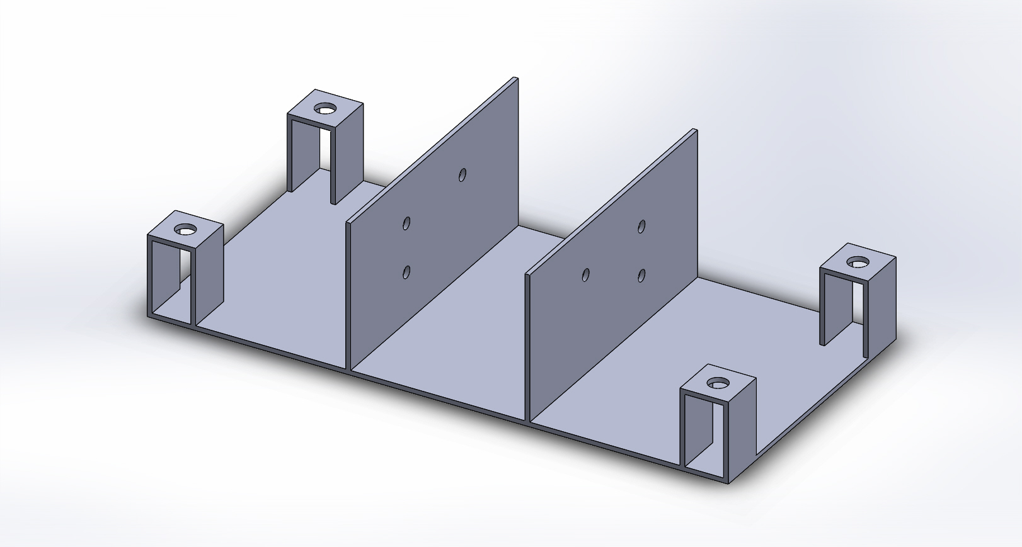
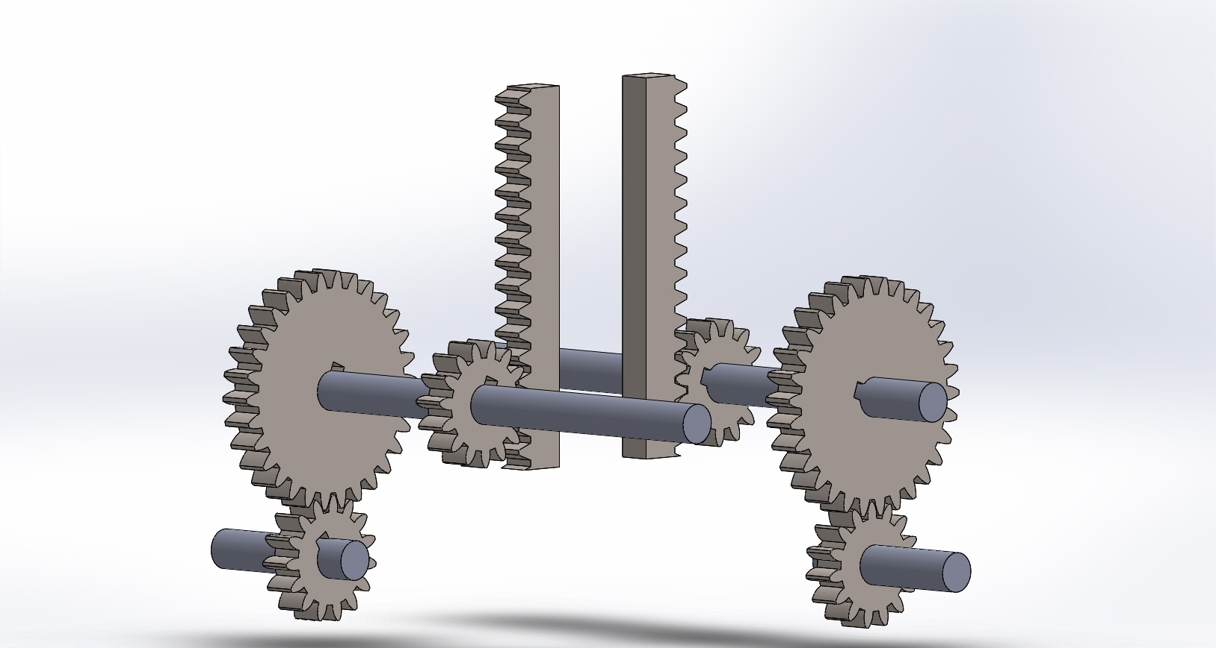
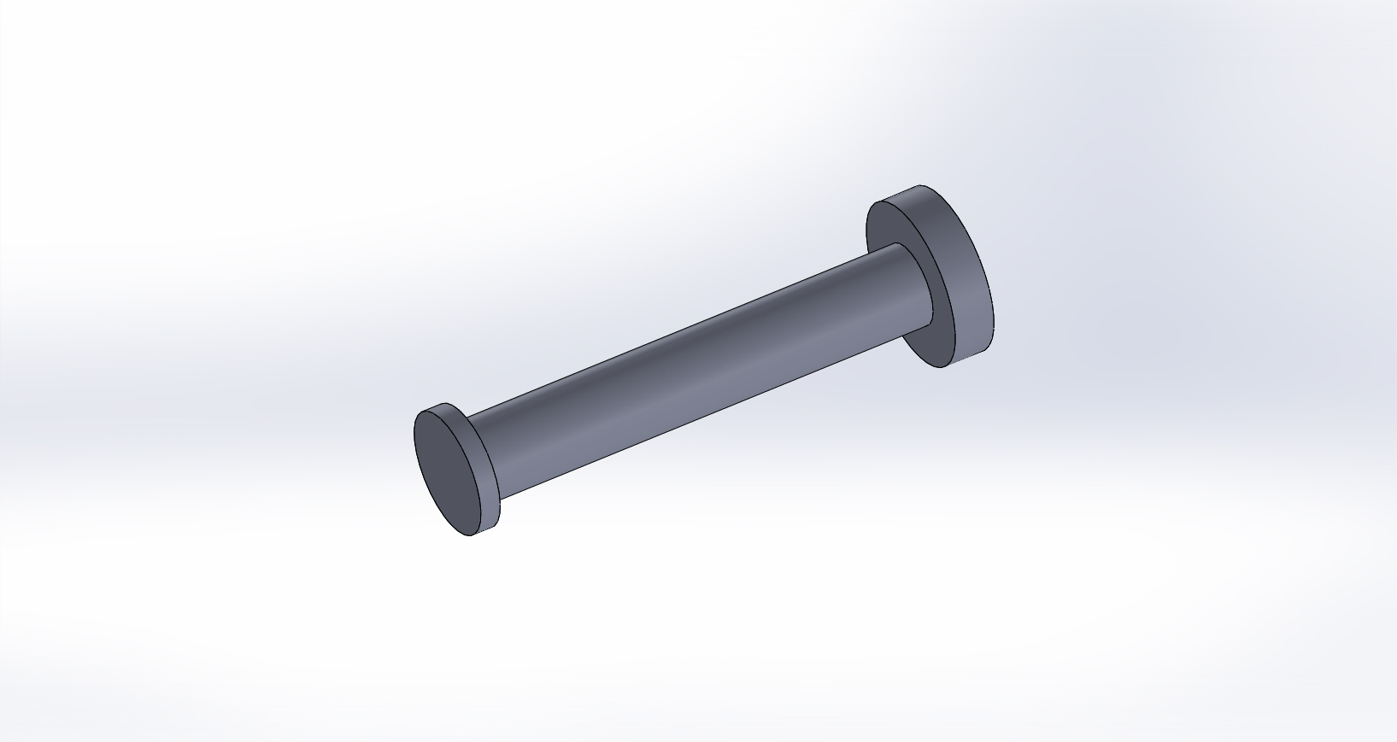
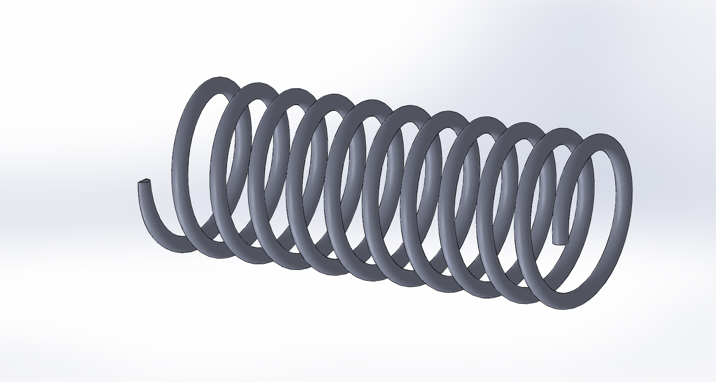
FABRICATION REQUIREMENTS
Gear Assembly
Base Plate
Moving Cylindrical Shaft
Spring

Slide 12
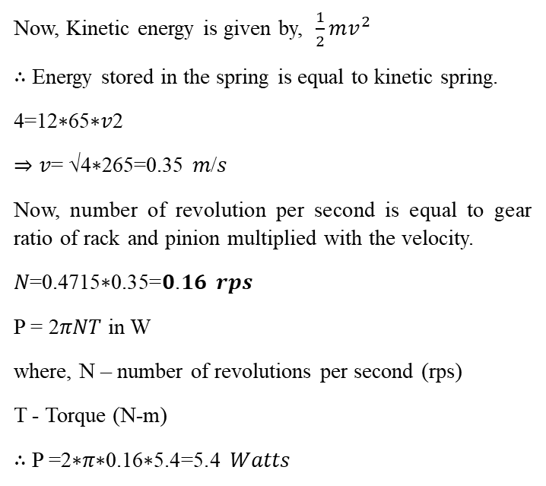
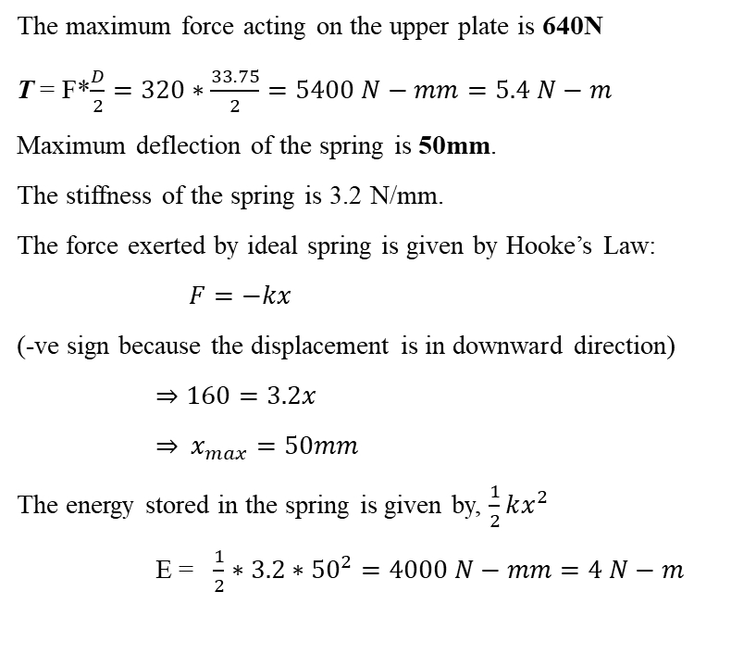
THEORETICAL POWER CALCULATIONS
The maximum force acting on the upper plate is 640N
T = F*$\frac{D}{2}=320∗\frac{33.75}{2}=5400 N−mm=5.4 N−m$
Maximum deflection of the spring is 50mm.
The stiffness of the spring is 3.2 N/mm.
The force exerted by ideal spring is given by Hooke’s Law:
$F=−kx$
(-ve sign because the displacement is in downward direction)
$⇒160=3.2x$
⇒ $x_{max}=50mm$
The energy stored in the spring is given by, $\frac{1}{2}kx^{2}$
E = $\frac{1}{2}∗3.2∗{50}^{2}=4000 N−mm=4 N−m$
Now, Kinetic energy is given by, $\frac{1}{2}mv^{2}$
∴ Energy stored in the spring is equal to kinetic spring.
4=12∗65∗𝑣2
⇒ 𝑣= √4∗265=0.35 𝑚/𝑠
Now, number of revolution per second is equal to gear ratio of rack and pinion multiplied with the velocity.
𝑁=0.4715∗0.35=𝟎.𝟏𝟔 𝒓𝒑𝒔
P = 2𝜋𝑁𝑇 in W
where, N – number of revolutions per second (rps)
T - Torque (N-m)
∴ P =2∗𝜋∗0.16∗5.4=5.4 𝑊𝑎𝑡𝑡𝑠

Slide 13
THEORETICAL POWER CALCULATIONS TABLE
Iteration | Mass (kg) | Load (N) | Deflection (mm) | Velocity (m/s) | Speed (rps) | Torque (N-m) | Power (Watts)
1. | 50 | 490 | 38.20 | 0.30 | 0.14 | 4.134 | 3.63
2. | 55 | 540 | 42.18 | 0.32 | 0.15 | 4.556 | 4.29
3. | 60 | 590 | 46.06 | 0.33 | 0.156 | 4.978 | 4.87
4. | 65 | 640 | 50.00 | 0.35 | 0.16 | 5.400 | 5.40

Slide 14
WORKING
We first step on the upper plate of the model, which in turn attached to four individual spring, four cylindrical rod and two rack.
The whole gear assembly is connected in between the two supporting walls and is supported by a base plate for stability.
When the force is applied on the upper plate, the plate and its attached parts move in the downward direction and the rack connected to pinion, starts rotating, which simultaneously rotates the compound gear and then, in turn rotates the small gear, which is connected to the output shaft of the generator, which generates electricity.

Slide 15
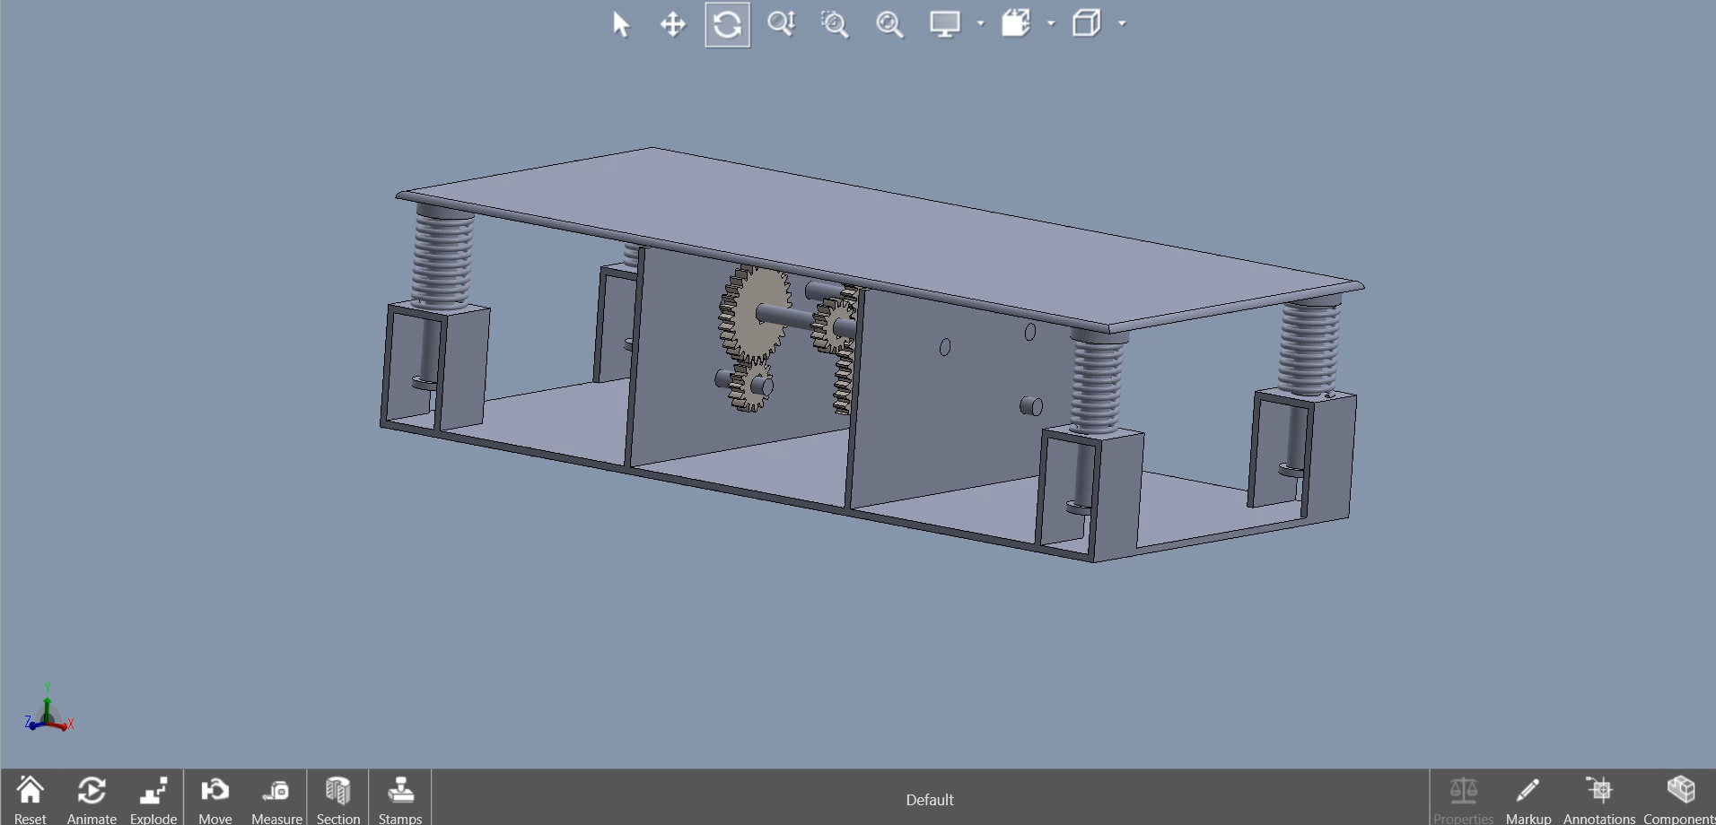
EXPLODED & 360° VIEW

Slide 16
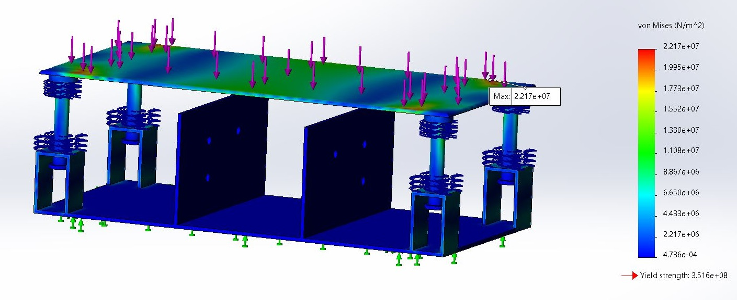
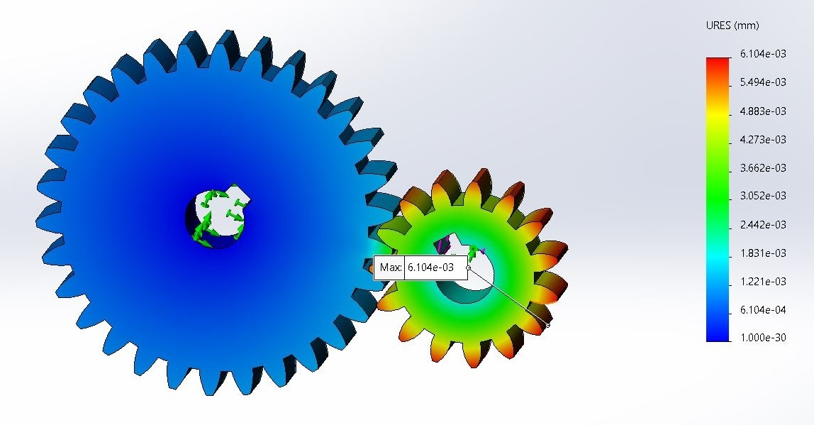
ANALYSIS
Von Mises Stress:
3.516 x 10⁸ N/m²
Factor of Safety: 2
Displacement: 0.427 x 10⁽⁻³⁾ m
Strain: 6.028 x 10⁽⁻⁵⁾
Since,
Maximum Stress < Yield Stress
∴ Frame Design is Safe.
Frame (Von Mises Stress)
Gear Assembly (Displacement)
Von Mises Stress:
3.673 x 10⁷ N/m²
Factor of Safety: 1.48
Displacement: 6.104 x 10⁽⁻³⁾ m
Strain: 1.422 x 10⁽⁻⁴⁾
Since,
Maximum Stress < Yield Stress
∴ Gear Design is Safe.

Slide 17
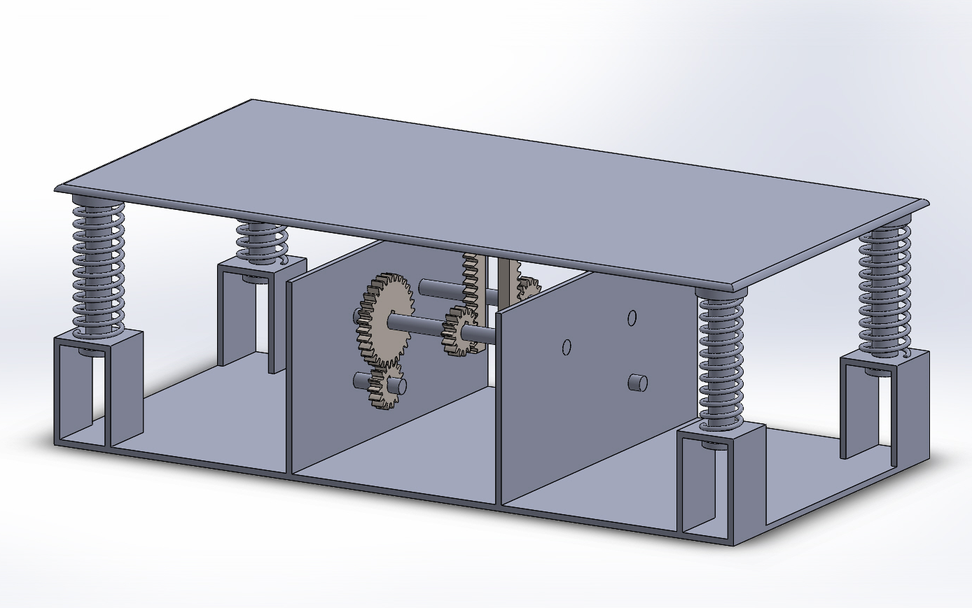
WORK PLAN
Identification of Complication
1-2 Days
Literature Review
2 Days
3D Model Design
2-3 Days
Fabrication of 3D Model
2-3 Weeks
Model Testing
1 Week
Modification on the Model
2 Week
Final Validation of Model
3 Days
Report Preparation
2 Days

Slide 18
EXPECTED OUTCOME
The general public & the planet earth are the end beneficiaries, due to below mentioned reasons:
Advantages:
Power is generated simply by stepping on the plate (Upper).
No need of fuel input.
Society can benefit from it by the following:
It is fully Eco-friendly.
No pollution content is produced.
While making this project, we learnt Solid Works[v20] (Design), Word Documentation (at corporate level) & PowerPoint Presentation & most important, Time Management & Team Work.

Slide 19
COST ESTIMATION
Sl. No. | Components | Details | Cost (in ₹)
1. | Base Plate & Upper Plate | Mild Steel, 600 * 300 mm [Base Plate], 600*300 mm [Upper Plate] | 1,000
2 | Shaft | M.S. Pipes, 12 mm diameter,190 mm length (190*2) | 300
3. | Moving Cylindrical Pipes | M.S. Pipes, 20 mm diameter, 115 mm length (115*4) | 400
4. | Springs | Chrome-vanadium steel, wire diameter 3.6 mm (110*4) | 600
5. | Rack & Pinion, Gear | Cast Iron, Module 2.25 | 1,400
6. | DC Generator | 12V, 60 RPM | 250
7. | Fabrication | Cutting, Welding, etc | 600
8. | Assembly | Mounting, Fixing motor shaft with pinion, Adjusting rack & pinion etc, & final welding | 500
Roughly Estimated Cost is around ₹ 5,000 to ₹ 5,500

Slide 20
REFERENCES
Mechanical Footstep Power Generation, India International Journal of Engineering Trends and Applications (IJETA) – Volume 5 Issue 2, Mar-Apr 2018
Design of Machine Elements 1 and 2, by Das J.B.K. Sapna Book Publication, First Edition.
All the design values have been referred from Machine Design Data Handbook
https://www.wikipedia.org
https://byjus.com/physics/dc-generator
https://my.solidworks.com/solidworks/guide/SOLIDWORKS_Introduction_EN.pdf
https://www.koyo.com.br/upload/koyo/cat203ex%20%20Ball%20&%20Roller%20Bearings.pdf
https://www.google.co.in/imghp?hl=en&authuser=0&ogbl

Slide 21
Any Further Questions? Or Suggestions That You Would Like to Add Upon?

Slide 22


